Slide 1
WHEN YOU CANNOT TRUST WHAT YOU SEE:
THE CONFOUNDING AND BEYOND
Anka Nieuwhof, Luis Braga, İrfan Dönmez ESPU research committee

Slide 2
Learning objectives
Identify and describe methods available to control confounding
Use stratification to evaluate potential confounders

Slide 3
Interpretation of study results
Results may be due to:
Causal association
Chance (random error)
Bias (systematic error)
Confounding
Notes:
Data from clinical trials comprises both signal and noise.
Maximizing signal and minimizing noise are crucial for accurate data analysis.
Random Error:
Arises due to working with a sample instead of the entire population.
Cannot be completely eliminated but can be reduced by increasing the sample size.
Systematic Error (Bias):
Results from inherent flaws in the study design or execution.
Increasing sample size does not reduce bias; it only magnifies it.
Efforts are made to minimize bias through trial design and measurement adjustments.

Slide 4
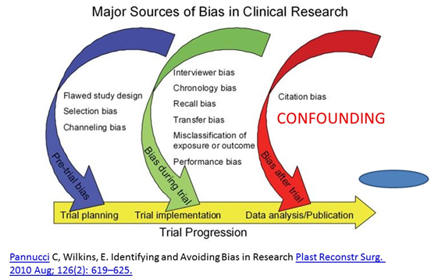
Different types of Bias
Notes:
A bias is a distortion of judgment that relies on a factor other than logic in coming to conclusions.

Slide 5
What is confounding?
External factor in an experiment impacting both independent and dependent variables.
Introduces error or bias, complicating determination of the independent variable's sole effect on the outcome.
Impact:
Confounding can distort the relationship between exposure and outcome, leading to misleading conclusions
It happens when a third factor is unevenly distributed among comparison groups.
Notes:
Confounding variables are variables that ‘confound’ (meaning to confuse) the data in a study.
extraneous variables that correlate (positively or negatively) with both the dependent variable and the independent variable

Slide 6
Example
Daily Screen Time and Obesity
Research suggests a link between extensive daily screen time and obesity.
But the confounding variable could be the lack of physical activity, which is often associated with both increased screen time and obesity.

Slide 7
Difference bias-confounding
Bias: Systematic error in measurement or reporting data.
Confounding: Real but misleading associations between variables.
.

Slide 8

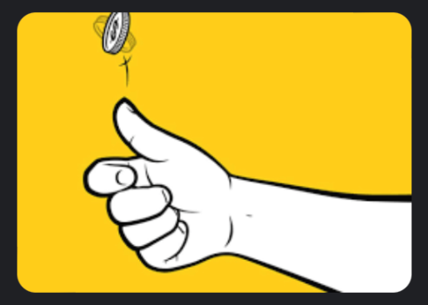

CONFOUNDING
Intrinsic limitation of observational studies
Well addressed by large RCTs
Small RCTs – can run into problems with confounding due to chance

Slide 9

CONFOUNDING - EXAMPLE
Observational study btw open vs robotic ureteral reimplantation looking at bladder spams, Foley catheter duration, hospital stay, complication rates
Open group – Cohen (intra-vesical)
Robotic group – Extra vesical approach
Intra-vesical – open bladder, tunnel dissection – hematuria – bladder wall closure – longer catheter (at least 72 hours)
Extra-vesical – no violation of bladder mucosa, no hematuria, bladder catheter maximum 24 hours

Slide 10


CONFOUNDING - EXAMPLE
Causal
Due to confounding
Open ureteral
reimplantation ↑
Open ureteral
reimplantation ↑
Observed association
Intra-vesical technique
Observed association
Hospital stay ↑
Hospital stay ↑

Slide 11


WHY IS THIS ISSUE IMPORTANT?
Presence of confounding
Alter with true association btw exposure and outcome
Biased results
Draw wrong conclusions

Slide 12

PREOPERATIVE TESTOSTERONE STIMULATION EXAMPLE

Slide 13

PRACTICE – HIS SURVEY

Slide 14


CONTROVERSY

Slide 15

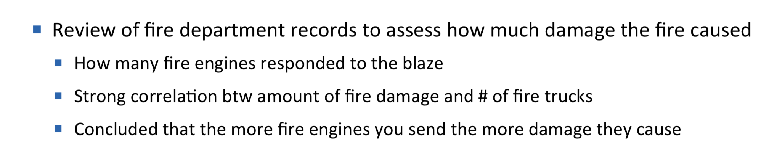



CAUSE AND EFFECT

Slide 16
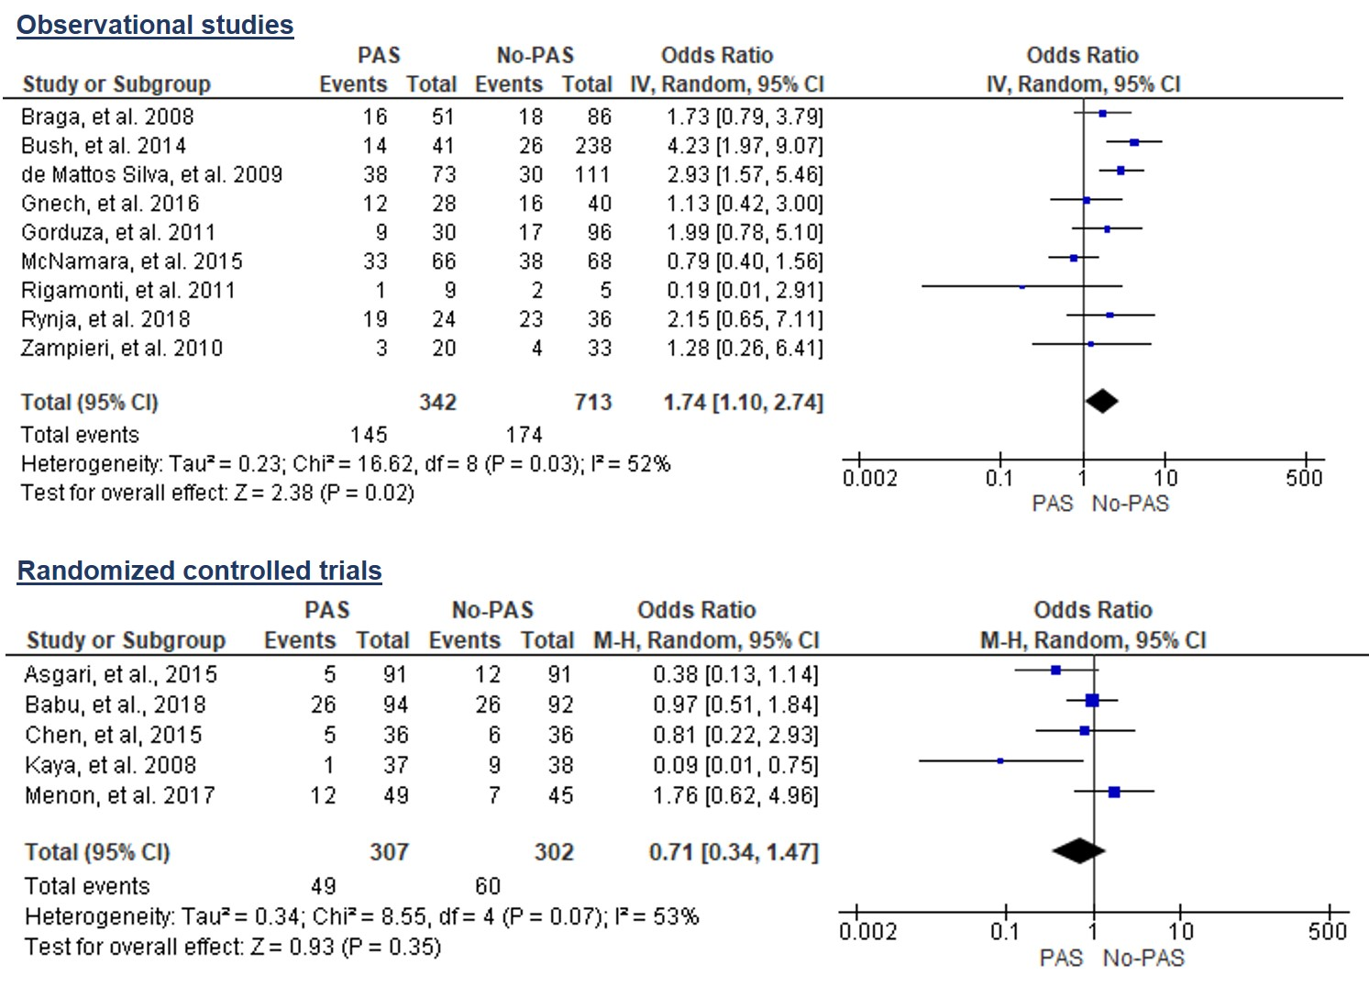

STUDY DESIGN
Li B, Braga LH et al. JPU 2019
Notes:
Just include the RCTs on this one to show the benefit of PHS
The other slide will show all the studies to demonstrate that the true effect may be masked if subgroup analysis was not done
Also include the reference so it shows our name here.

Slide 17

CONFOUNDING BY INDICATION - SELECTION BIAS
Severity of hypospadias – known risk factor for complications
The more proximal the defect – the higher the complication rate
Proximal cases – more likely to have “small penis” – more likely to receive testosterone stimulation
Confounding by indication - biased association btw exposure (PTS) and outcome (complications) in which pts are allocated to a treatment group based on their baseline characteristics.
This selection bias can only be reduced with randomization – probably explains the difference in the treatment effect estimates btw observational studies vs RCTs
Notes:
For example in the previously slide the study declared a 13‐fold increase in the odds of developing a post hypospadias repair complication when performing a caudal block
Following bivariate analysis, caudal anesthesia was shown to have an unadjusted odds ratio (OR) of 16.5 with a 95% confidence interval (CI) of 2.2‐123.8.
Even after using multivariable analysis and including only two covariates in their model, the adjusted OR for postoperative surgical complications with caudal block was 13.4, with a still very wide 95% CI, spanning from 1.8 to 101.8, which indicates a substantial amount of imprecision for the estimate of the treatment effect.
The wider the 95% CI, the less precise our outcome measure typically is, which casts doubt on the true association of the effect.
The extremely wide 95% CIs presented in this paper lead us to question whether the strong magnitude of effect is spurious due to low numbers of events, and/or due to selection bias toward the indication of caudal blocks for more severe proximal hypospadias cases.

Slide 18

PENILE BLOCK VS. CAUDAL EXAMPLE
Thus far, 12 studies with conflicting results
What is the reason for that?

Slide 19
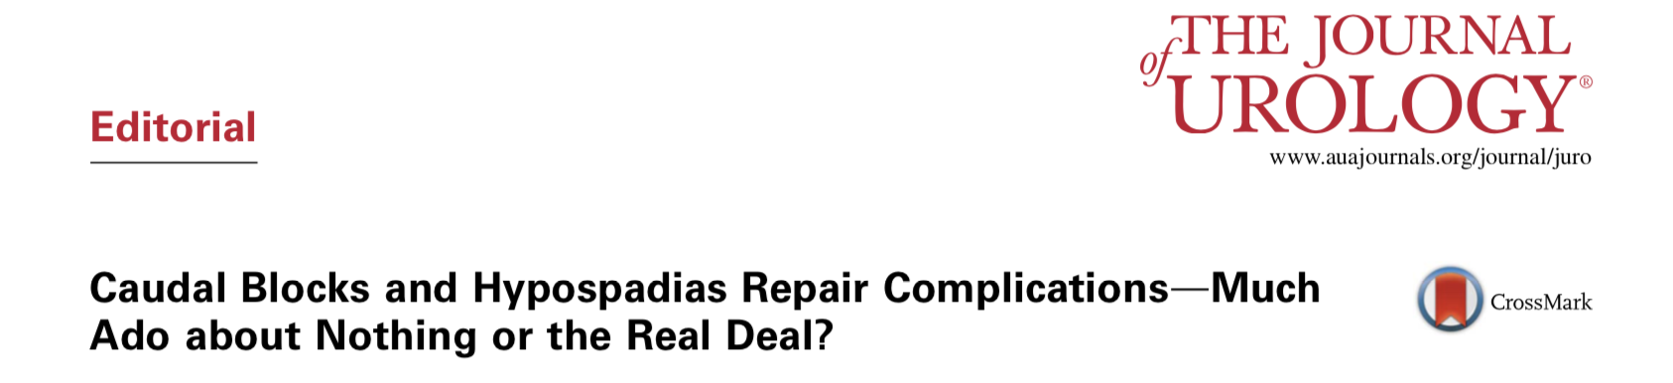

CONFLICTING EVIDENCE
J Routh 2021
Based on low quality evidence – has stopped using caudal
Justification – not possible to conduct an RCT

Slide 20
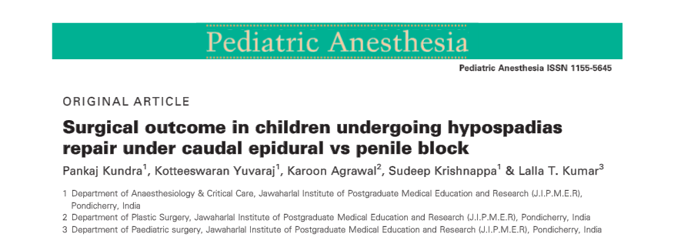

INTERNAL VALIDITY
How confident one can be that the relationship between the variable (risk factor) and the outcome is true.
RCTs – cause and effect relationship
Observational studies – association
The less the amount of confounding – the higher the internal validity
Notes:
Internal validity is the extent to which a study establishes a trustworthy cause-and- effect relationship (association, in case of observational studies) between a variable (risk factor) and an outcome. The less amount of confounding effect in a study, the higher the internal validity and the more confident one can be in its findings.

Slide 21

INTERNAL VALIDITY
Single surgeon vs. multi-surgeon hypospadias series
When should we do it?
Complications of a certain technique in an institution/country – yes
Risk factors for complications – no
Different surgeons - no standard protocol - high variability
Decreases internal validity – inaccurate (biased) results
Notes:
It is a common belief that generalizability of any study can be improved by simply having a large number of surgeons as part of that sample, as this would reflect a broader clinical practice representation. This is normally the case when the study’s intent is to report on overall complication rate of a certain technique in a large institution or in a specific country.
In studies in which the main goal is to pinpoint a particular risk factor for surgical complications, having such high variability in surgical technique and postoperative care by having several surgeons (no standard protocol to be followed) decreases the study’s internal validity, and may lead to inaccurate results. Therefore, sometimes, having several surgeons with different practices may not be better, but it may actually be worse from a methodological standpoint.

Slide 22
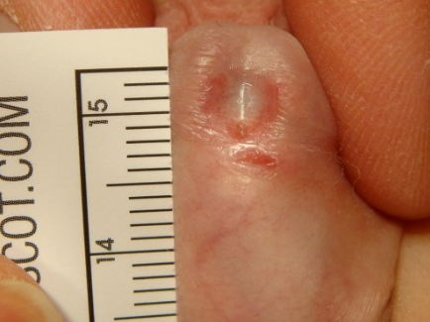
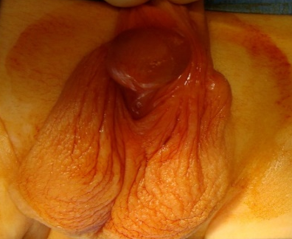

SELECTION BIAS
The choice of regional anesthesia - subjectively decided by the surgical and anesthetic teams
Reasons - underlying differences in pts’ baseline characteristics – cannot be accounted for in statistical analyses
Distal – higher probability of getting a DPB
Proximal – more likely to have a CB
Notes:
In the majority of hypospadias studies comparing DPB to CEB, the choice of regional anaesthesia is subjectively decided by the surgical and anaesthetic teams on the day of surgery, leading to inherent selection biases. The reasons for selecting a child to receive one block over the other may be related to underlying differences in patients’ baseline characteristics between the 2 groups that cannot be accounted for in the statistical analyses.
A major methodological limitation of observational studies and contributes to the underestimation or overestimation of the treatment effect. Once bias has occurred, its extent and direction cannot be adjusted for by any statistical analysis, leading to spurious results

Slide 23
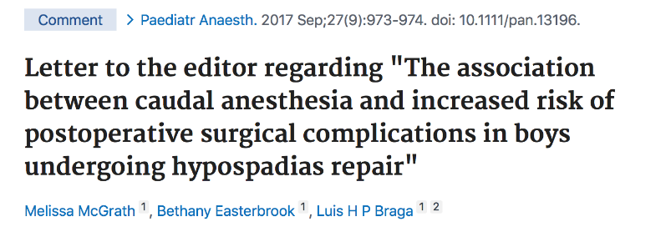
SELECTION BIAS
Selection bias – very few proximal cases had DPB
OR = 13 (95% CI: 1.8 – 102)
The wider the 95% CI, the less precise the treatment effect
Very wide CIs due to low number of events (very few DPB done in pts with proximal hypospadias) could lead to spurious results
Notes:
For example in the previously slide the study declared a 13‐fold increase in the odds of developing a post hypospadias repair complication when performing a caudal block
Following bivariate analysis, caudal anesthesia was shown to have an unadjusted odds ratio (OR) of 16.5 with a 95% confidence interval (CI) of 2.2‐123.8.
Even after using multivariable analysis and including only two covariates in their model, the adjusted OR for postoperative surgical complications with caudal block was 13.4, with a still very wide 95% CI, spanning from 1.8 to 101.8, which indicates a substantial amount of imprecision for the estimate of the treatment effect.
The wider the 95% CI, the less precise our outcome measure typically is, which casts doubt on the true association of the effect.
The extremely wide 95% CIs presented in this paper lead us to question whether the strong magnitude of effect is spurious due to low numbers of events, and/or due to selection bias toward the indication of caudal blocks for more severe proximal hypospadias cases.

Slide 24

CONFOUNDING
Do not include MAGPI and TIP repairs in the same series, UNLESS
MAGPI more likely to get a DPB
Surgical technique is included in the multivariable model to account for confounding effect
Or subgroup analysis selecting only one technique is done - more homogenous sample

Slide 25

SAMPLE SIZE
A small sample size is not always the problem.
A low number of events impacts more the power of the study (less precision).
Lack of precision is evident when 95% CI is wide.
In these circumstances, results may show statistical significance, BUT
if lower boundary of the 95% CI is close to 1, the true estimate could be almost at the line of no effect.
Notes:
A modest sample size or, more importantly, a low number of events contributes to the study being underpowered, with low precision. This lack of precision becomes evident when one looks at the width of the 95% confidence interval (CI). The interpretation of the 95% CI is that the probability of the true treatment effect lying somewhere in-between its 2 extreme values is 95%. In the hypospadias literature, it is not un- common to identify studies in which the lower boundary of the 95% CI is very close to the null value of 1 when the treatment effect is reported as risk ratio or odds ratio. Even though study results may show statistical significance in these circumstances, having the lower boundary of the 95% CI almost reaching 1 indicates that the true point estimate could be very close to the line of no effect for the intervention under study. In such cases, p values may fail to provide clinicians with the information they most need, i.e., the range of values within which the true effect is likely to reside. Instead, CIs provide information on the magnitude, direction and statistical significance of the treatment effect in a form that pertains directly to the process of deciding whether a certain intervention (DPB or CEB) is associated with favourable or unfavourable out- comes. If the range of the 95% CI is overly wide, pediatric urologists may choose to adopt a DPB or a CEB selectively, or not at all.

Slide 26
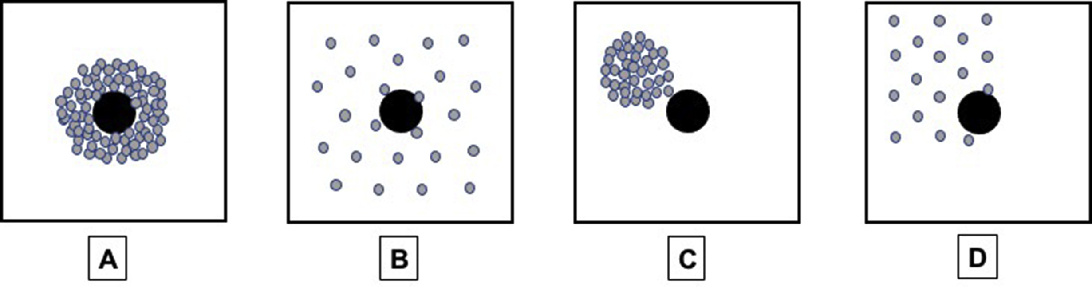
ACCURACY AND PRECISION
Braga LH et al. J Ped Urol 2020
Large RCT
Accurate and
precise
Small RCT
Accurate, but
less precise
Large Observ. study
Less accurate,
but precise
Small Observ. study
Less accurate and
less precise
Notes:
Another way of interpreting very wide 95% CIs is that the probability of the estimated treatment effect being due to chance alone may be higher than what is expected by using the traditional thresholds of significance (5%). In other words, it denotes that the odds of either DPB or CEB being associated with higher complication rates post distal hypospadias repair are likely similar to those of the comparative intervention. Fig. 1 displays 4 squares, which represent results from 4 different studies. The first 2 squares illustrate randomized controlled trials (RCT) and the last 2 observational studies.

Slide 27


WHY NON-RANDOMIZED STUDIES MISLEAD?
Convenience sampling - no sample size calculation
Selection bias - surgeon preference
Confounding by indication
Lack of standardized protocols = measurement bias
Reporting and observer biases - lack of outcome assessor blinding
Wang Y, Braga LH. J Pediatr Urol 2020
Notes:
For example in this study it was unclear how the authors decided to choose the number of patients included in the treatment group (18) versus the control group (23). No sample size calculation was evident to justify the sampling conducted, leaving doubt to whether the results were due to chance alone.
It was also doubtful how the authors chose to assign which patients would receive treatment (PHS) compared to those who would not. The lack of randomization in the study design increases the risk of selection bias and makes the results less robust.
Furthermore, the authors noted that only patients with proximal hypospadias and mild to moderate curvature were included in this study. However, it was unclear how reliable and valid the preoperative assessment of curvature for proximal cases used in this study was. The most accurate way of measuring penile curvature is with an intraoperative erection test, and, more recently, using an objective measurement tool, such as a goniometer.
Furthermore, due to the unblinded nature of the treatment groups, a very real possibility of reporting, performance and observer bias may have greatly influenced the results. As parents were told to watch for these specific testosterone side effects, it is more likely that they would report any of such occurrences, as opposed to those parents in the control group, who did not have to look for any side effect, as their boys did not receive PHS.

Slide 28

How to Identify the Confounder/s?
Make sure the relationship fits the confounding criteria
The confounding factor must be associated with both the risk factor of interest and the outcome.
The confounding factor must be distributed unequally among the groups being compared.
A confounder cannot be an intermediary step in the causal pathway from the exposure of interest to the outcome of interest.

Slide 29
How to Identify the Confounder/s?
Variable
Confounding
Association
Exposure Outcome
NOT Confounding
Exposure Outcome
Variable

Slide 30
How to Identify the Confounder/s?
Compare the associations before and after adjusting for that confounding factor.
>10% difference in association → most likely confounding
Clinically meaningful relationship between the variable and the risk factor & between the variable and the outcome
Perform formal tests of hypothesis to assess whether the variable is associated with the exposure of interest and with the outcome

Slide 31

How to Minimize the Confounder/s?
At the time of study design
At the time of analysis

Slide 32
How to Minimize the Confounder/s?
At the time of study design
Restriction
Get rid of possible counfoundings by excluding (Age, gender, medication, circumcision status etc.)
Cannot evaluate the excluded factors
Harder to achieve adequate patient number
Loss of generalizability
Might still include unidentified confounders

Slide 33
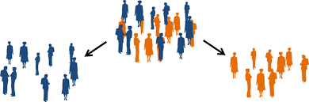
How to Minimize the Confounder/s?
Matching
Pairing possible confounding factors (age, gender, VUR status, degree of hypospadias, type of intervention etc.)
Paired factor can’t be investigated
Avoid overmatching
Prone to data loss and bias

Slide 34
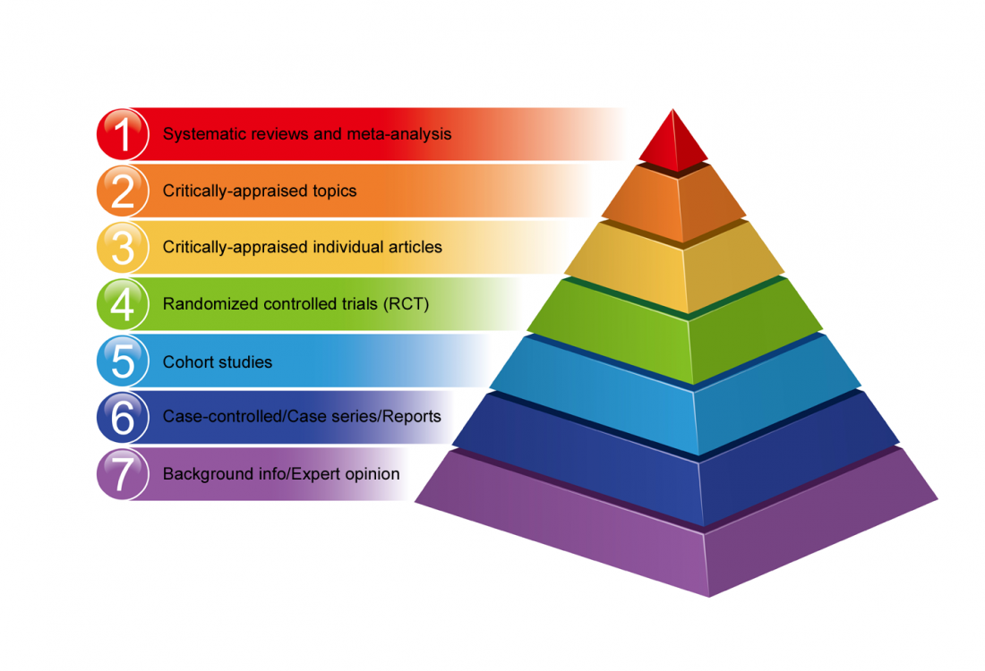
How to Minimize the Confounder/s?
Randomization (RCT)
Balancing both measured and unmeasured confounders between study groups
Factors can still remain, however
the effect is minimalized

Slide 35
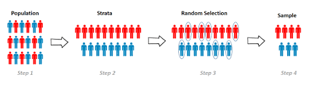
How to Minimize the Confounder/s?
At the time of data analysis
Stratification
Adjusted/Unadjusted effects should taken into account (not p value)
Stratify participants into subgroups according to a third variable considered to be a potential confounder (Age, gender, LUTD status, testis location etc.)
Difficult to handle multiple confounders

Slide 36


How to Minimize the Confounder/s?
 | Age < 2 |  |  |  |  | Age ≥ 2
 | OCD | No OCD | Total |  |  | OCD | No OCD | Total
Prox | 10 | 90 | 100 |  | Prox | 36 | 164 | 200
Distal | 35 | 465 | 500 |  | Distal | 25 | 175 | 200
Total | 45 | 555 | 600 |  | Total | 61 | 339 | 400
Stratum specific RR (Age <2) Stratum specific RR (Age ≥2)
Combined (Unadjusted or Crude) RR of the sample: 1.79

Slide 37
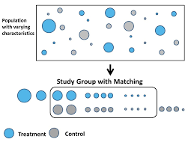
How to Minimize the Confounder/s?
Propensity score matching
Adjusts risk factors (apple to apple comparison)
Reduce selection bias
Better for 2 groups comparison
Requires advanced statistical knowledge

Slide 38
How to Minimize the Confounder/s?
Multiple variable regression analysis
Powerful but complex
Requires a small number of possible confounding factors
It allows us to estimate the effects on a dependent predictor variable of changing, while holding the other explanatory variables constant.

Slide 39
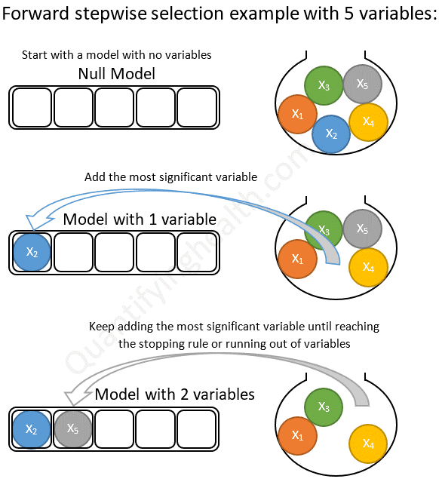
How to Minimize the Confounder/s?
After stratification (Age, gender, disease severity etc.)
Use multiple logistic regression to simultaneously adjust for several confounding factors

Slide 40
Take home message
Confounding threats the validity of nonexperimental studies
Selection bias major threat to validity of any study (not specific to nonexperimental studies)
Proper research questions and study design are more important than analysis
Stratification and the use of multivariable regression models are methods of correcting for confounding, which means that study groups are balanced concerning confounding factors.
Notes:
- Confounding by indication and frailty pose significant threats to validity in nonexperimental studies:
- Confounding by indication occurs when the indication for treatment is also associated with the outcome, making it challenging to attribute effects solely to the treatment.
- Frailty refers to the susceptibility of certain individuals to adverse outcomes due to factors beyond the treatment being studied, which can confound results.
- Selection bias is a major threat to the validity of any study, regardless of its experimental or nonexperimental nature:
- Selection bias occurs when there is a systematic difference between the characteristics of those selected for the study and those who are not, leading to biased estimates of treatment effects.
- Emphasizes the importance of proper research question formulation and study design:
- Highlights that having a well-defined research question and selecting an appropriate study design are more crucial than the analysis method employed.
- Suggests that a robust study design can mitigate potential biases and confounding factors, ensuring more valid conclusions.

Slide 41

Look-Understand-Correct

Slide 42








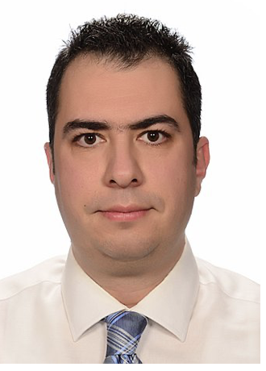
Thank You!!!!
The ESPU Research Committee
Luke Harper
(Chair, FR)
Massimo Garriboli
(UK)
Salvatore Cascio
(IRL)
Luis Braga
(CAN)
Caleb Nelson
(USA)
Anka Nieuwhof-Leppink
(Vice-Chair (NL)
M. İrfan Dönmez
(TUR)
Christina Ching
(USA)
Bernhard Heid
(AUS)

