Slide 1
SURGICAL INTERVENTION OF RETRACTILE TESTICLES INCREASE VOLUME AND SPERM FUNCTION Fossum, Magdalena Division of Pediatric Urology, Dept. of Highly specialized Pediatric Surgery and Pediatric Medicine Karolinska University hospital and Karolinska Institutet in Stockholm, Sweden
Objectives:
To prospectively assess testicular growth following orchidopexy
for 2ary ascended testicle
Secondary outcomes were testicular atrophy and whether outcomes
were dependent on the experience of the operating surgeon
Notes:
Note: Presentation of the abstract with several samples of BIAS.
Single-author abstract presented in “own” session. Gone through ordinary reviewing process?? NO! ☺
Based on peer reviews, the ESPU scientific committee would probably have accepted this abstract for a poster presentation. However, BIAS, does not make this a convincing paper. Note: ESPU protocol on how to grade an abstract J Pediatr Urol. 2018 Jul 21

Slide 2
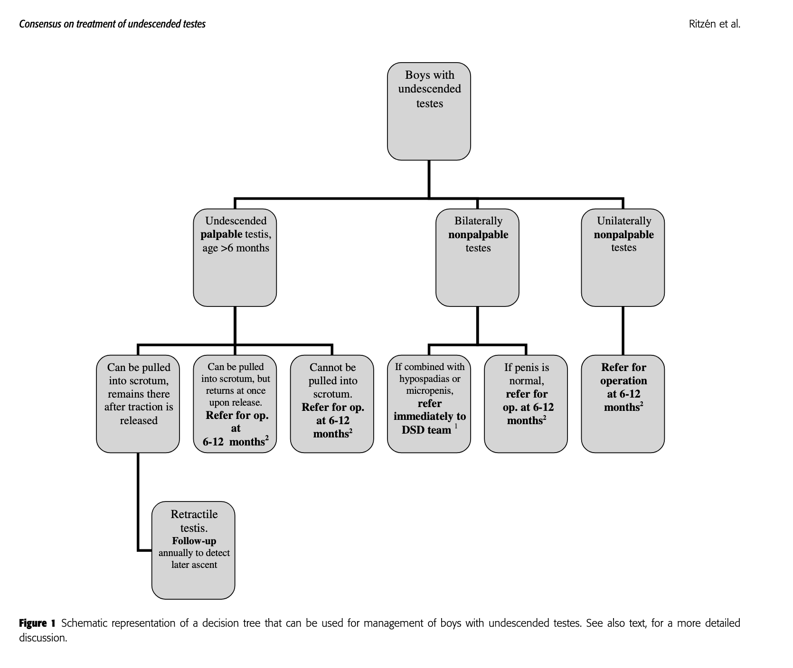
Background
Acta Pediatrica 2006
Notes:
The Nordic consensus statement advocate orchidopexy at an early age for primary non-descended testicles (6-12 months of age). The rationale for early intervention is to reduce the risk of later malignancy and to increase fertility. In the present study we sought to investigate the outcomes of surgical intervention of secondary non-descended testicles at a tertiary Swedish center. The patient group in mind are the ones in the bottom box.
( The author is at least NOT biased by being part of the Nordic consensus group ☺ )

Slide 3
Study design
Prospective study
Patient group: boys with unilateral ascending testicles (previously diagnosed as retractile testicles)
Ultrasound for volume measurements. Size of inguinal testicle was compared with contralateral side. Index was used (undescended/descended)
New volume assessment 1-6 months after the surgical repair. Volume assessment with orchidometer.
Control group: 20 boys with normal testicular status
Definitions
Index < 1 (smaller retracted testicle)
Testicular atrophy was defined as >50% loss of volume
Or postoperative volume <25% of the contralateral testicle
Patients were excluded for incomplete data or loss for follow-up
Notes:
BIASES in study design: 1. Confounding factor such as: Early after surgery. Still post-op swelling. 2. Time in high inguinal position not calculated (some might have gotten early intervention others later). 3. Control group: All boys < 10 years old in extended family/ neighborhood (from same two families)/ all from same non-Swedish/ non-European region.
3. Assessment by palpation different from assessment with ultrasound. Risk of BIAS. (In addition: assessor knowing which side has been operated on) 4. Patients were excluded for incomplete data or loss for follow-up. Data not corresponding with what was wanted?

Slide 4
Demographics
 | Age (mean) | P-value | Volume (ml) Descended testicle Left | P-value | Volume (ml) Descended testicle Right | P- value
Cases (100) | 4.6 | 0,98 | 6,3 (65 cases) | 0,95 | 5,8 (35 cases) | 0,9
Control (20) | 4,5 |  | 6,5 |  | 5,9
Notes:
Age span can be very important. I.e. mean age in one group might include an age span of 2-15 whereas the other group might be 3-5 years, this may impact size of testicles a lot.

Slide 5
Results
Data from 100 patients were analyzed
All had 2ary ascent and had undergone ipsilateral repair for non-descended testis
Preop. inguinal testicles where smaller than contralateral side (p<0,05)
Catch-up growth with a larger post-operative volume was found in half of cases
Half of testicles were larger than in control subjects
Secondary outcomes
Testicular atrophy occurred in 2.5% of cases
There was no reported testicular re-ascent
There was no significant difference in outcomes comparing the experience of surgeon (consultant n = 2, trainee surgeon n = 2)
Notes:
Comments for questioning:
All boys from other surgeons in at the department were excluded. All the ones were inguinal hernia was not found had been operated with Bianchi method and these were excluded
Who assessed the patients? The surgeon- yes!
US compared with manual control. (preop US on inguinal testicle BUT manual on the other side)
follow-up in the present cohort was short (median 3 months), VERY short follow-up
Comparison with contralateral testicle is not reported. If this had been done maybe the difference between manual palpation vs Ultrasound might have been found.

Slide 6
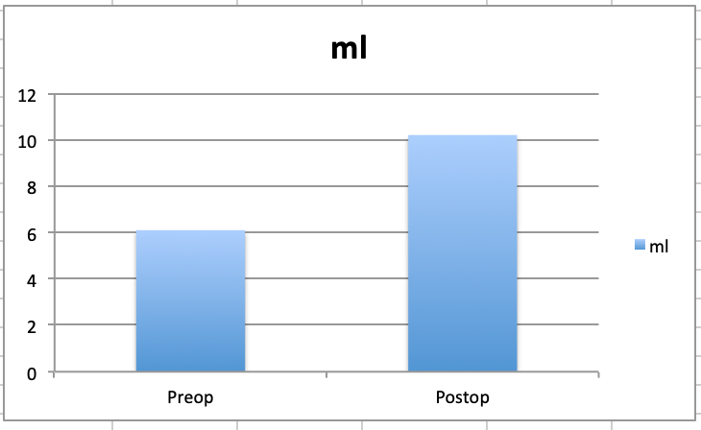
Results: increase in volume after surgery
P<0,05
Notes:
Bars demonstrating variability would be valuable. Note, volume PREOP was measured with ultrasound but POSTOP was measured manually about 3 months after surgery.

Slide 7
Conclusion
Early operation of 2ary ascended testicles seems favorable as testicular size can be a proxy for function
The mechanism for testicular catch-up growth is not well understood
The present study concerning secondary non-descended testicles reported a low rate of re-ascending (2.5%)
Testicular atrophy was not dependent on the experience of the operating surgeon
Thank you!
Notes:
This slide Is just to demonstrate how conclusions could have been stated in this FAKE poster presentation related to BIAS.

Slide 8
Study design
Prospective study
Patient group: boys with unilateral ascending testicles (previously diagnosed as retractile testicles)
Ultrasound for volume measurements. Size of inguinal testicle was compared with contralateral side. Index was used (undescended/descended)
New volume assessment 1-6 months after the surgical repair. Volume assessment with orchidometer.
Control group: 20 boys with normal testicular status.
Definitions
Index < 1 (smaller retracted testicle)
Testicular atrophy was defined as >50% loss of volume or postoperative testicular volume <25% of the volume of the contralateral testis.
Patients were excluded for incomplete data or loss for follow-up.
Notes:
How did you find your control subjects?
Any limitations to the methods and investigation
Where all colleagues involved in acquiring patients?
Was all available data considered?
What statistical tests did you use?
Are you part of the Nordic consensus group?
BIASES in study design: 1. Confounding factor such as: Early after surgery. Still post-op swelling. 2. Time in high inguinal position not calculated (some might have gotten early intervention others later). 3. Control group: All boys < 10 years old in extended family/ neighborhood (from same two families)/ all from same non-Swedish/ non-European region.
3. Assessment by palpation different from assessment with ultrasound. Risk of BIAS. (In addition: assessor knowing which side has been operated on) 4. Patients were excluded for incomplete data or loss for follow-up. Data not corresponding with what was wanted?

Slide 9
Study design
Prospective study
Patient group: boys with unilateral ascending testicles (previously diagnosed as retractile testicles)
Ultrasound for volume measurements. Size of inguinal testicle was compared with contralateral side. Index was used (undescended/descended)
New volume assessment 1-6 months after the surgical repair. Volume assessment with orchidometer.
Control group: 20 boys with normal testicular status.
Definitions
Index < 1 (smaller retracted testicle)
Testicular atrophy was defined as >50% loss of volume or postoperative testicular volume <25% of the volume of the contralateral testis.
Patients were excluded for incomplete data or loss for follow-up.
Notes:
How did you find your control subjects?
Any limitations to the methods and investigation
Where all colleagues involved in acquiring patients?
Was all available data considered?
What statistical tests did you use?
Are you part of the Nordic consensus group?
BIASES in study design: 1. Confounding factor such as: Early after surgery. Still post-op swelling. 2. Time in high inguinal position not calculated (some might have gotten early intervention others later). 3. Control group: All boys < 10 years old in extended family/ neighborhood (from same two families)/ all from same non-Swedish/ non-European region.
3. Assessment by palpation different from assessment with ultrasound. Risk of BIAS. (In addition: assessor knowing which side has been operated on) 4. Patients were excluded for incomplete data or loss for follow-up. Data not corresponding with what was wanted?

Slide 10
Study design
Prospective study
Patient group: boys with unilateral ascending testicles (previously diagnosed as retractile testicles)
Ultrasound for volume measurements. Size of inguinal testicle was compared with contralateral side. Index was used (undescended/descended)
New volume assessment 1-6 months after the surgical repair. Volume assessment with orchidometer.
Control group: 20 boys with normal testicular status.
Definitions
Index < 1 (smaller retracted testicle)
Testicular atrophy was defined as >50% loss of volume or postoperative testicular volume <25% of the volume of the contralateral testis.
Patients were excluded for incomplete data or loss for follow-up.
Notes:
How did you find your control subjects?
Any limitations to the methods and investigation
Where all colleagues involved in acquiring patients?
Was all available data considered?
What statistical tests did you use?
Are you part of the Nordic consensus group?
BIASES in study design: 1. Confounding factor such as: Early after surgery. Still post-op swelling. 2. Time in high inguinal position not calculated (some might have gotten early intervention others later). 3. Control group: All boys < 10 years old in extended family/ neighborhood (from same two families)/ all from same non-Swedish/ non-European region.
3. Assessment by palpation different from assessment with ultrasound. Risk of BIAS. (In addition: assessor knowing which side has been operated on) 4. Patients were excluded for incomplete data or loss for follow-up. Data not corresponding with what was wanted?

Slide 11
Study design
Prospective study
Patient group: boys with unilateral ascending testicles (previously diagnosed as retractile testicles)
Ultrasound for volume measurements. Size of inguinal testicle was compared with contralateral side. Index was used (undescended/descended)
New volume assessment 1-6 months after the surgical repair. Volume assessment with orchidometer.
Control group: 20 boys with normal testicular status.
Definitions
Index < 1 (smaller retracted testicle)
Testicular atrophy was defined as >50% loss of volume or postoperative testicular volume <25% of the volume of the contralateral testis.
Patients were excluded for incomplete data or loss for follow-up.
Notes:
How did you find your control subjects?
Any limitations to the methods and investigation
Where all colleagues involved in acquiring patients?
Was all available data considered?
What statistical tests did you use?
Are you part of the Nordic consensus group?
BIASES in study design: 1. Confounding factor such as: Early after surgery. Still post-op swelling. 2. Time in high inguinal position not calculated (some might have gotten early intervention others later). 3. Control group: All boys < 10 years old in extended family/ neighborhood (from same two families)/ all from same non-Swedish/ non-European region.
3. Assessment by palpation different from assessment with ultrasound. Risk of BIAS. (In addition: assessor knowing which side has been operated on) 4. Patients were excluded for incomplete data or loss for follow-up. Data not corresponding with what was wanted?

Slide 12
Study design
Prospective study
Patient group: boys with unilateral ascending testicles (previously diagnosed as retractile testicles)
Ultrasound for volume measurements. Size of inguinal testicle was compared with contralateral side. Index was used (undescended/descended)
New volume assessment 1-6 months after the surgical repair. Volume assessment with orchidometer.
Control group: 20 boys with normal testicular status.
Definitions
Index < 1 (smaller retracted testicle)
Testicular atrophy was defined as >50% loss of volume or postoperative testicular volume <25% of the volume of the contralateral testis.
Patients were excluded for incomplete data or loss for follow-up.
Notes:
How did you find your control subjects?
Any limitations to the methods and investigation
Where all colleagues involved in acquiring patients?
Was all available data considered?
What statistical tests did you use?
Are you part of the Nordic consensus group?
BIASES in study design: 1. Confounding factor such as: Early after surgery. Still post-op swelling. 2. Time in high inguinal position not calculated (some might have gotten early intervention others later). 3. Control group: All boys < 10 years old in extended family/ neighborhood (from same two families)/ all from same non-Swedish/ non-European region.
3. Assessment by palpation different from assessment with ultrasound. Risk of BIAS. (In addition: assessor knowing which side has been operated on) 4. Patients were excluded for incomplete data or loss for follow-up. Data not corresponding with what was wanted?

Slide 13
How would this abstract be graded by the ESPU grading team?
BACKGROUND:
The Nordic consensus statement advocate orchidopexy at an early age for primary non-descended testicles (6-12 months of age). The rationale for early intervention has been to reduce the risk of later malignancy and to increase fertility. In the present study we sought to investigate the outcomes of surgical intervention of secondary non-descended testicles at a tertiary Swedish center.
OBJECTIVE:
To prospectively assess testicular growth following orchidopexy for secondary undescended testes in a pediatric population. Secondary outcome were testicular atrophy and whether outcomes were dependent on the experience of the operating surgeon.
Problem description : Clear (+5 p)
Notes:
Clear objective

Slide 14
STUDY DESIGN:
In a prospective study, 100 unilateral ascending testicles (previously diagnosed as retractile testicles) that were palpable in the inguinal region but could not be mobilized to a withstanding position in the scrotum, was assessed by ultrasound for volume measurements. Size of inguinal testicle was compared with contralateral side. New volume assessment was made by palpation and comparison with an orchidometer 1-6 months after the surgical repair. Another group with normal testicular status was used as controls (20 subjects).
Prospective data regarding age at operation, classification of the undescended testis, length of follow-up, and comparison of intraoperative and postoperative testicular volumes compared with the contralateral testis were collected . Testicular atrophy was defined as >50% loss of testicular volume or a postoperative testicular volume <25% of the volume of the contralateral testis. Patients were excluded for incomplete data or loss for follow-up.
Method: Prospective, large group, clear definitions, Matched control group (+25 p)

Slide 15
RESULTS:
Data for 100 patients were analyzed. Testicular atrophy occurred in 2.5% of cases. All secondary cases underwent an ipsilateral repair for non-descended testis. There was no reported testicular re-ascent. There was no significant difference in outcomes comparing the experience of surgeon (consultant n = 2, trainee surgeon n = 2). Postoperative catch-up growth with a larger post-operative volume was found in half of cases. Half of testicles were larger than in control subjects.
Results: Concise sentences, new and important
(10 p)

Slide 16
DISCUSSION:
Previous studies have reported a testicular atrophy rate of 5% after repair of primary non-descended testicle. The present study concerning secondary non-descended testicles reported a lower rate of 2.5%. It was also found that testicular atrophy was not dependent on the experience of the operating surgeon. Animal studies have supported the hypothesis that increased temperature has a detrimental effect on testicular volume. However, follow-up in the present cohort was short (median 3 months), making interpretation of this finding difficult. Good testicular size has been acknowledged as a marker for good function related to spermatogenesis.
CONCLUSION:
Catch-up growth after surgery was found after repair of secondary ascended testicles. The mechanism for testicular catch-up growth is not well understood.
Conclusion: Valid (0 p) (no penalty)
In summary: probably around 80-90 p from each reveiwers
→ Accepted poster!
Notes:
Would recon that the reviewer would think that all outcomes were analyzed and concluded on. The testicles were compared within the same patient but also with a control group. Some kind of index was used- a little bit unclear but could probably be sorted out at the presentation. Important to know that retractile testicles should be followed yearly in order to operate promptly. …. Abstract should be accepted!

Slide 17
ESPU scientific committee would probably have accepted this abstract for a poster presentation. However, BIAS, does not make this a convincing paper. In this example we visualize the importance of: - peer reviewing - scientific communications - ethics and honesty in research

